Slide 1


Slide 2

2025 Recap
Top 10 Units
Top 10 Scouts
Rank | Unit | District | Sales
1 | Pack 710 | River's Edge | $86,584
2 | Pack 424 | Spirit Lake | $52,701
3 | Pack 209 | River's Edge | $50,513
4 | Troop 162 | Pacific Trail | $42,167
5 | Troop 7476 | Santiam River | $36,372
6 | Pack 095 | Spirit Lake | $34,339
7 | Troop 452 | River's Edge | $33,359
8 | Pack 443 | Spirit Lake | $26,935
9 | Pack 872 | Pacific Trail | $24,786
10 | Pack 199 | River's Edge | $21,211
Scout Rank | Scout Name | District Name | Unit Name | Scout Sales
1 | Dhillon D | Spirit Lake | Pack 424 | $17,222
2 | Caden s | River's Edge | Pack 209 | $16,949
3 | Elliott B | River's Edge | Pack 710 | $12,111
4 | Jasper R | Pacific Trail | Troop 162 | $11,820
5 | Calla P | Pacific Trail | Troop 162 | $10,052
6 | Brett W | Spirit Lake | Pack 424 | $7,051
7 | Samuel C | Santiam River | Troop 7476 | $6,447
8 | Brayden K | Santiam River | Troop 7476 | $6,350
9 | Archer R | River's Edge | Pack 710 | $6,193
10 | Lincoln R | River's Edge | Pack 710 | $6,115
Total 2025 Sales: $729,270
Over a 23% Increase!

Slide 3
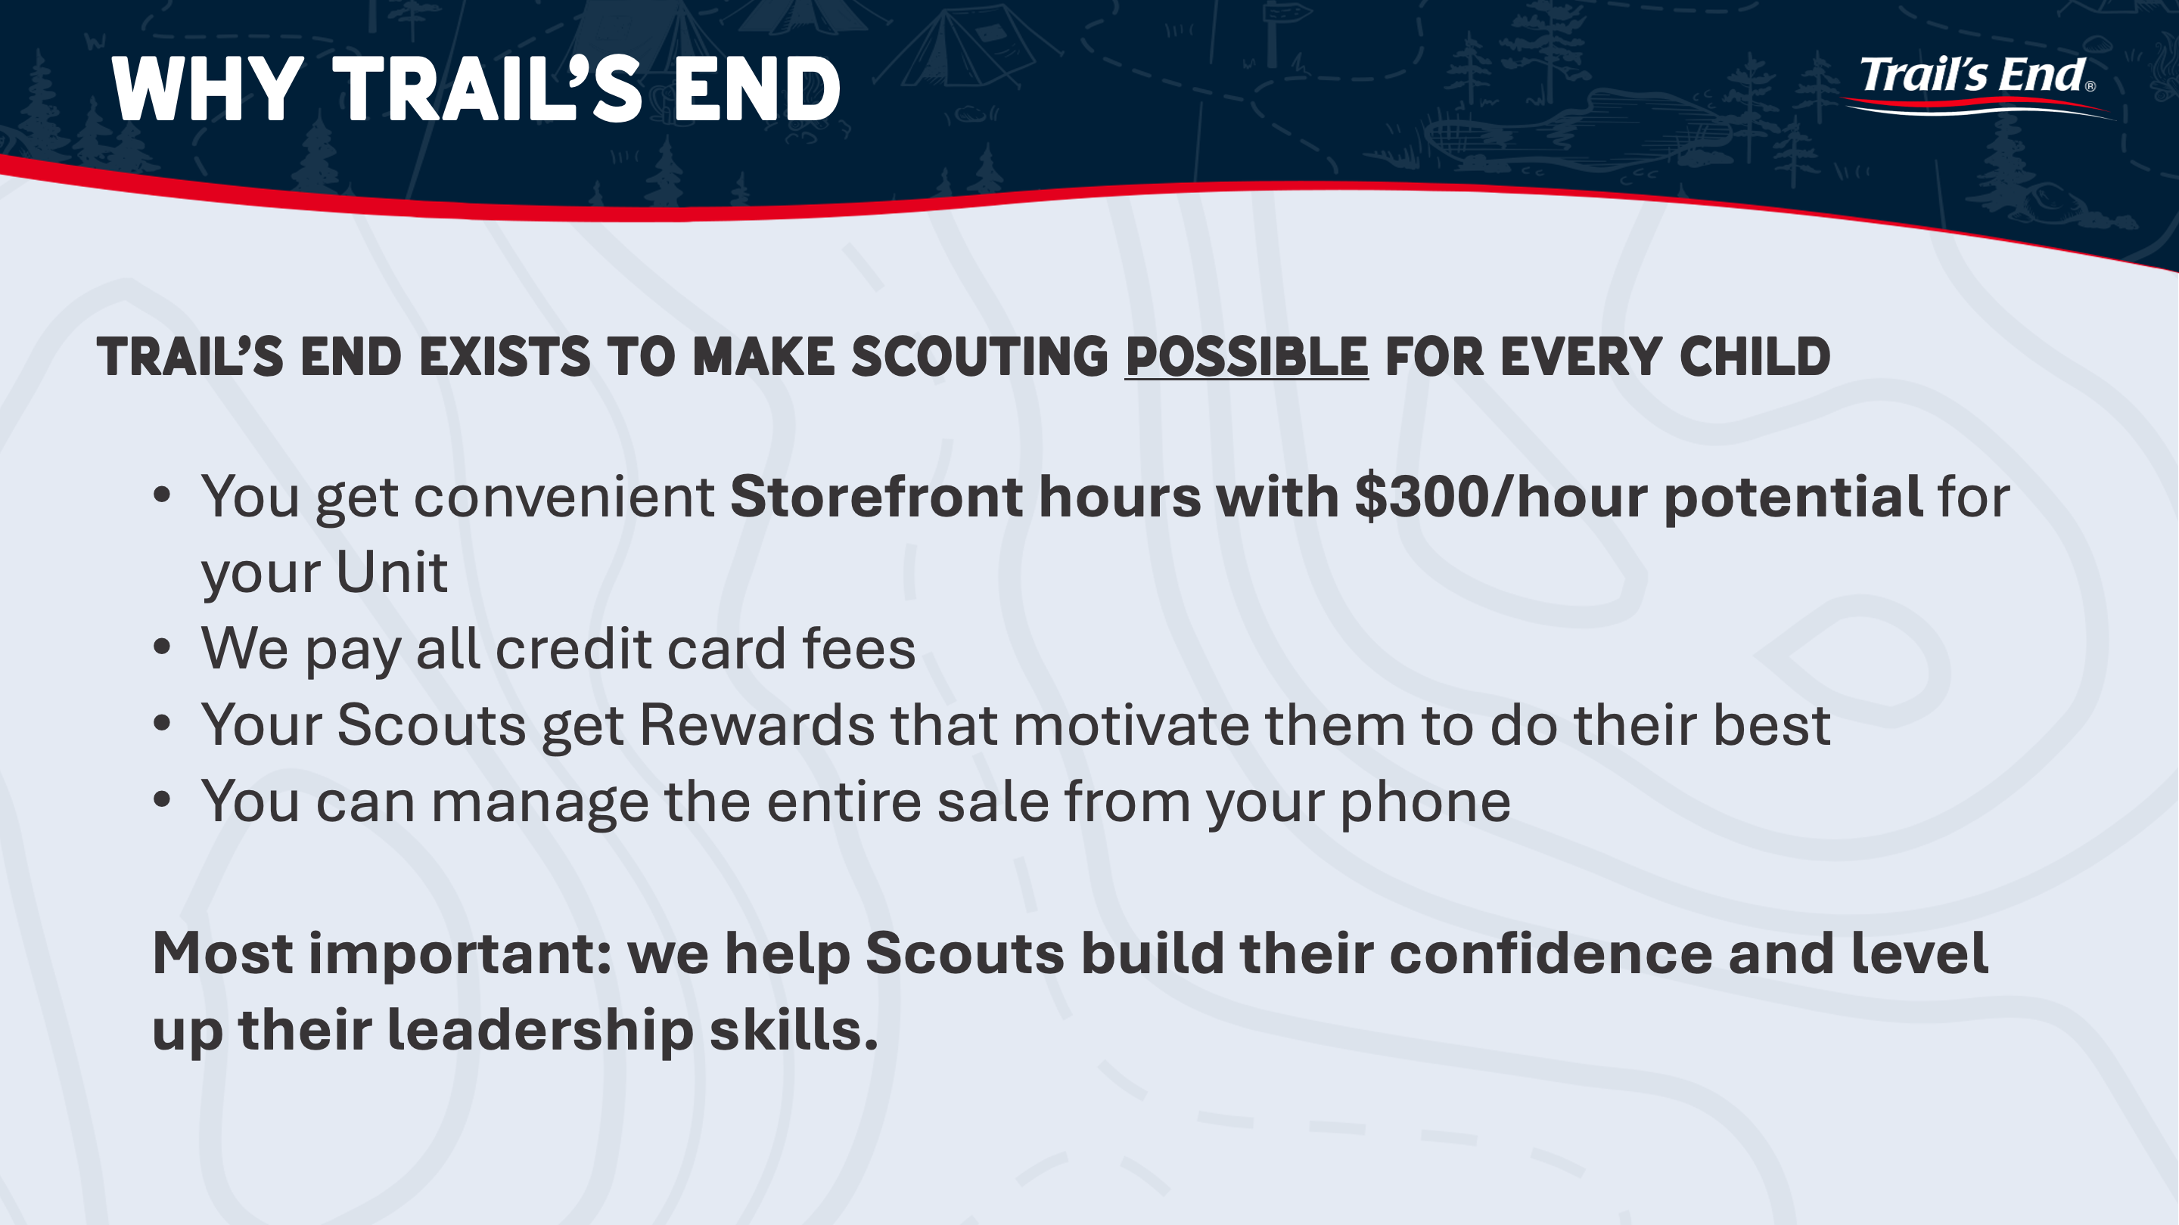

Slide 4


Slide 5
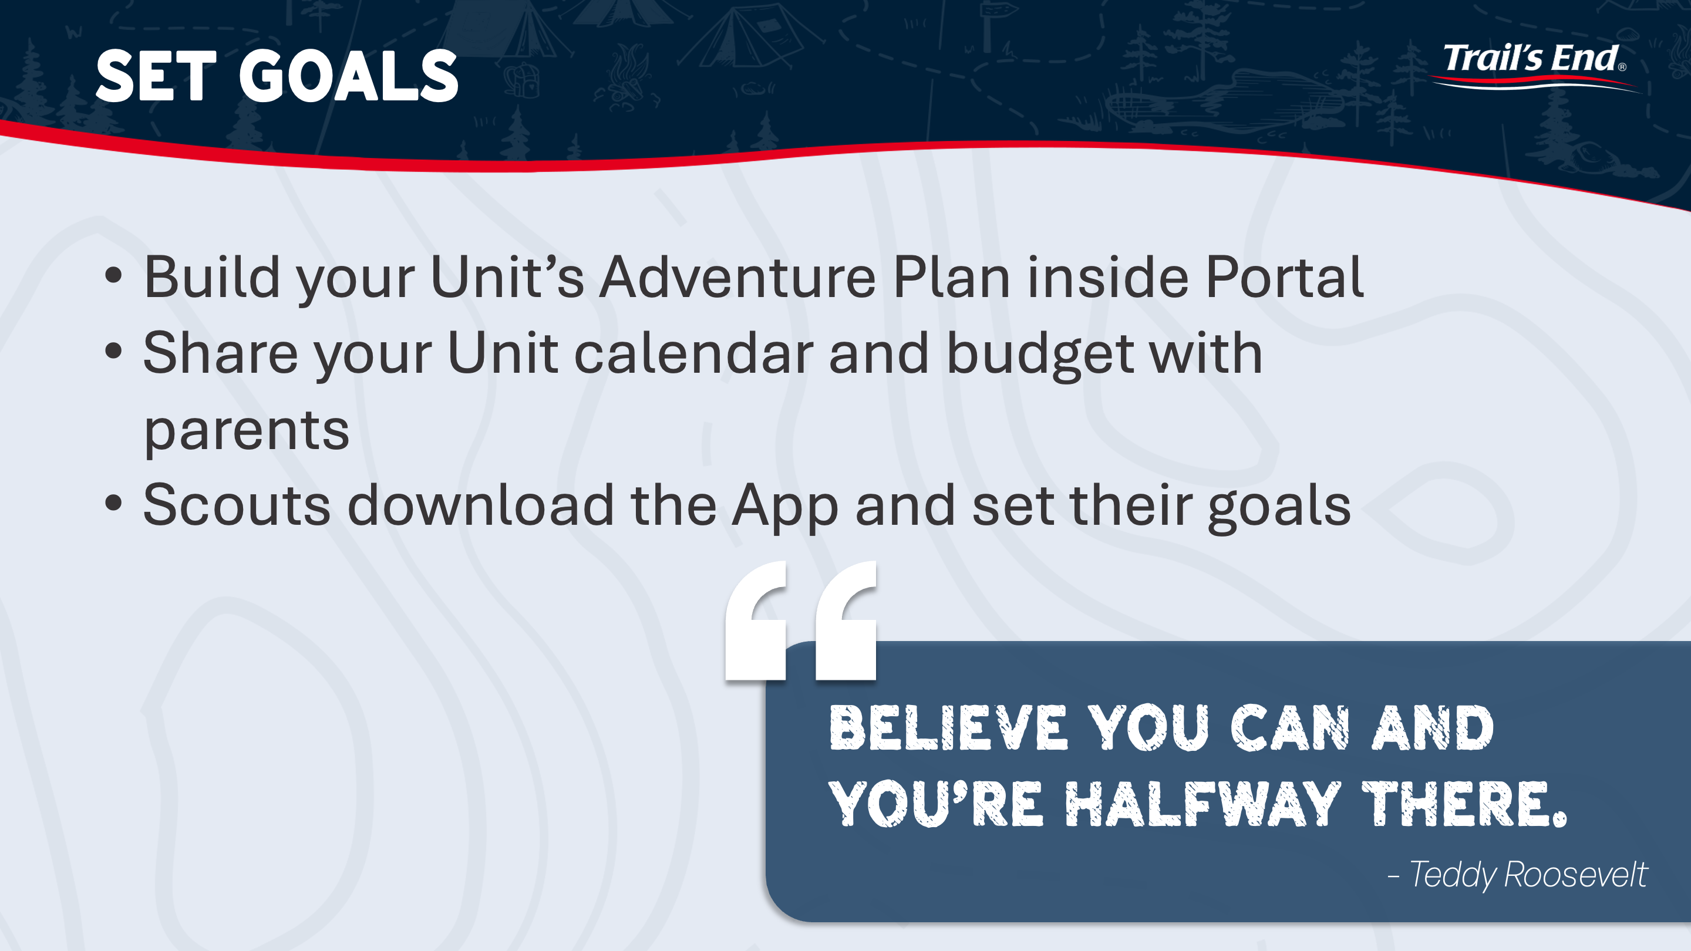

Slide 6
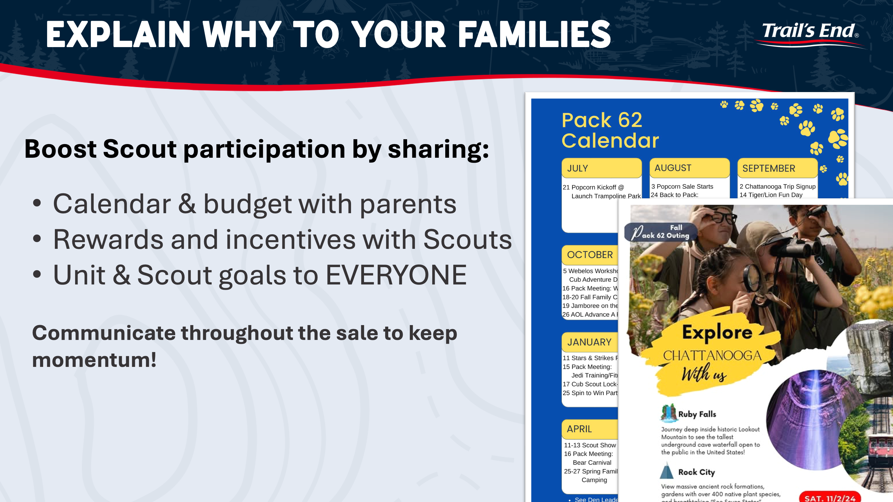

Slide 7
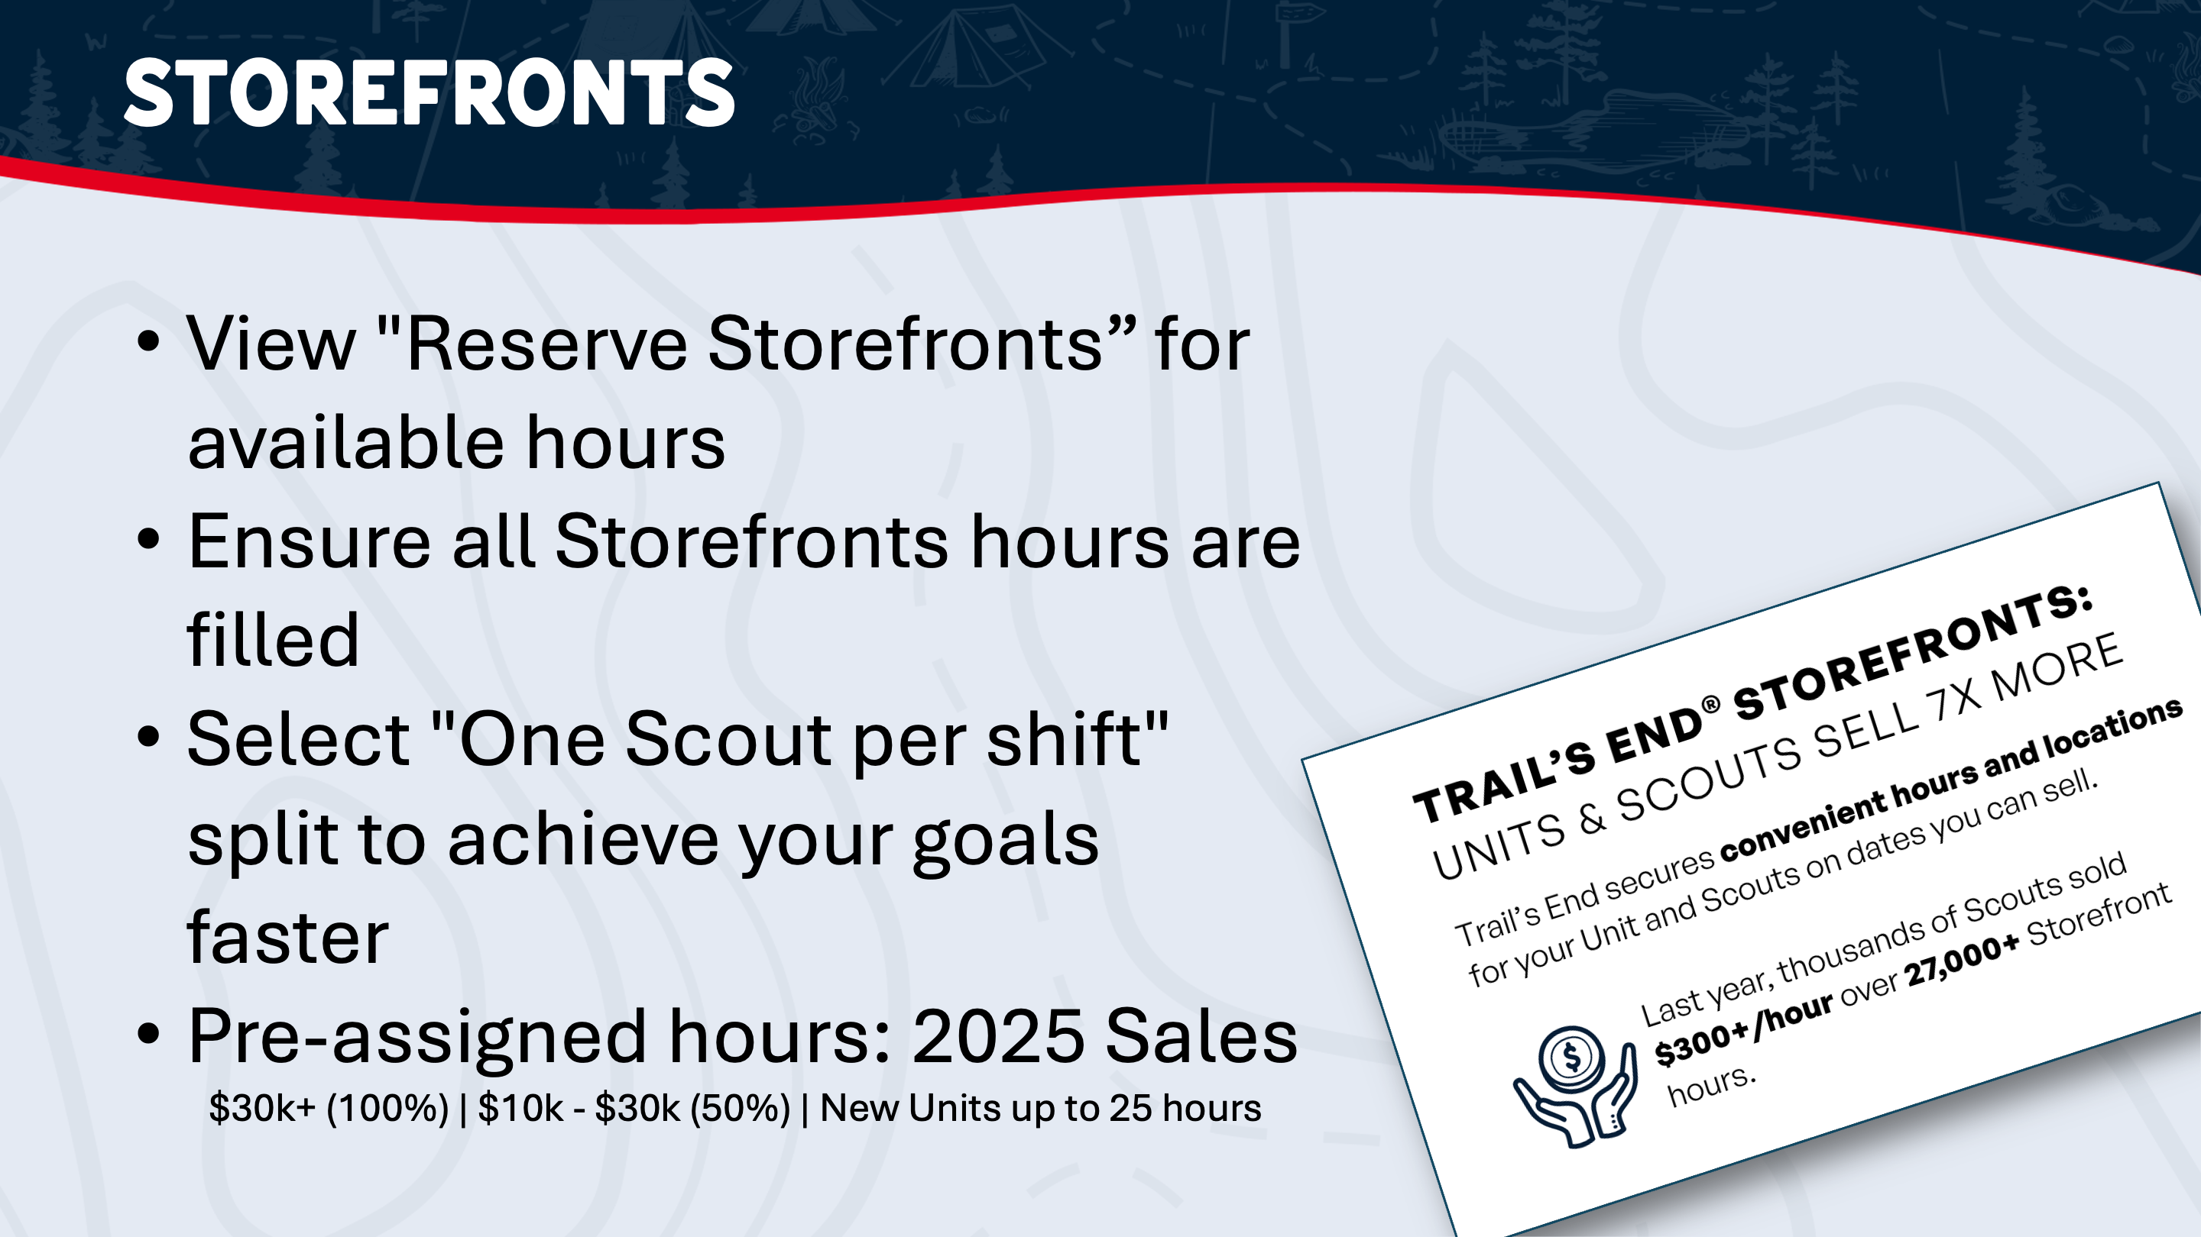

Slide 8


Slide 9
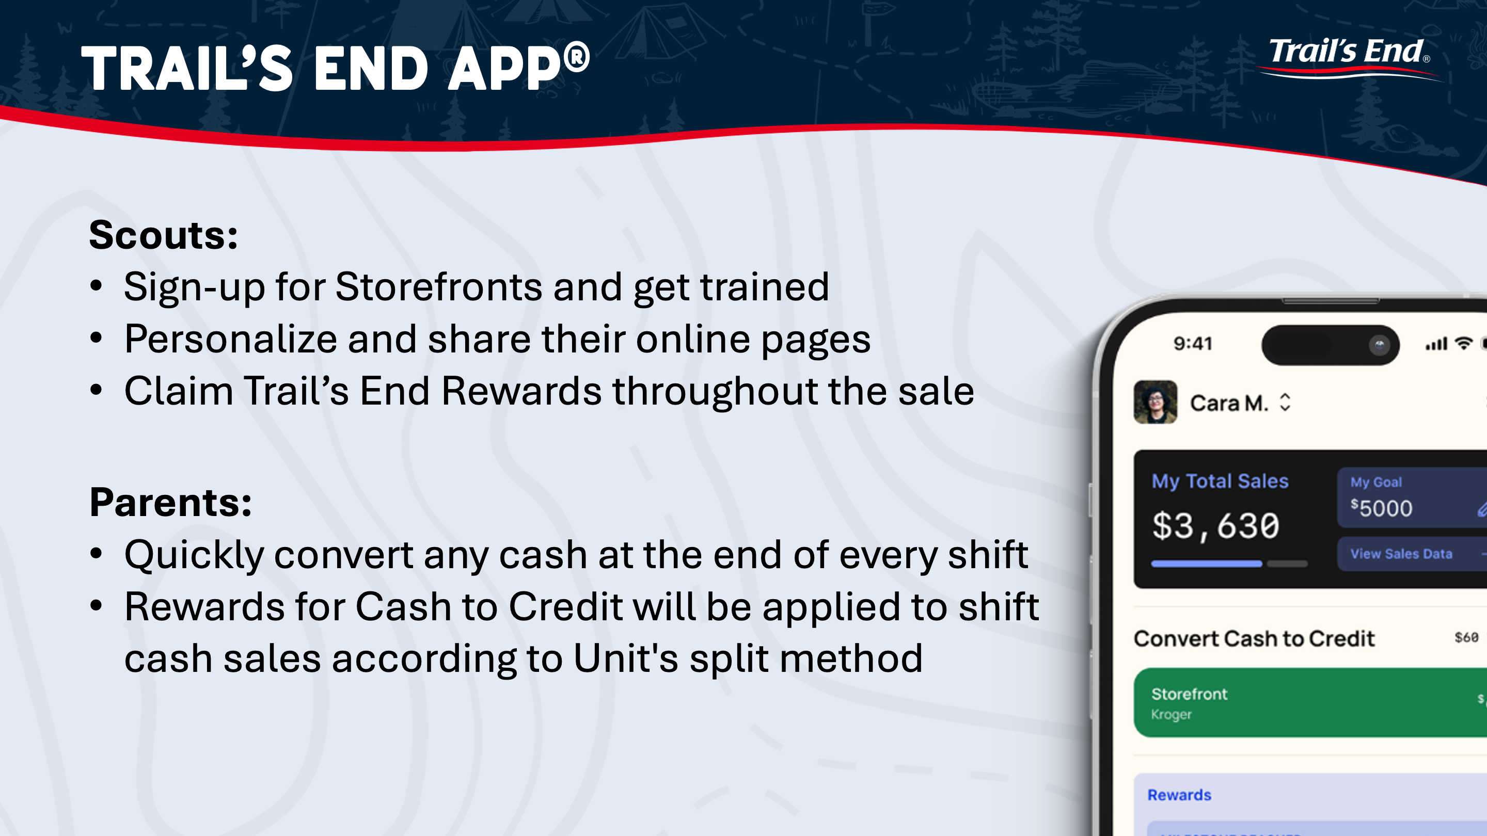

Slide 10


Slide 11
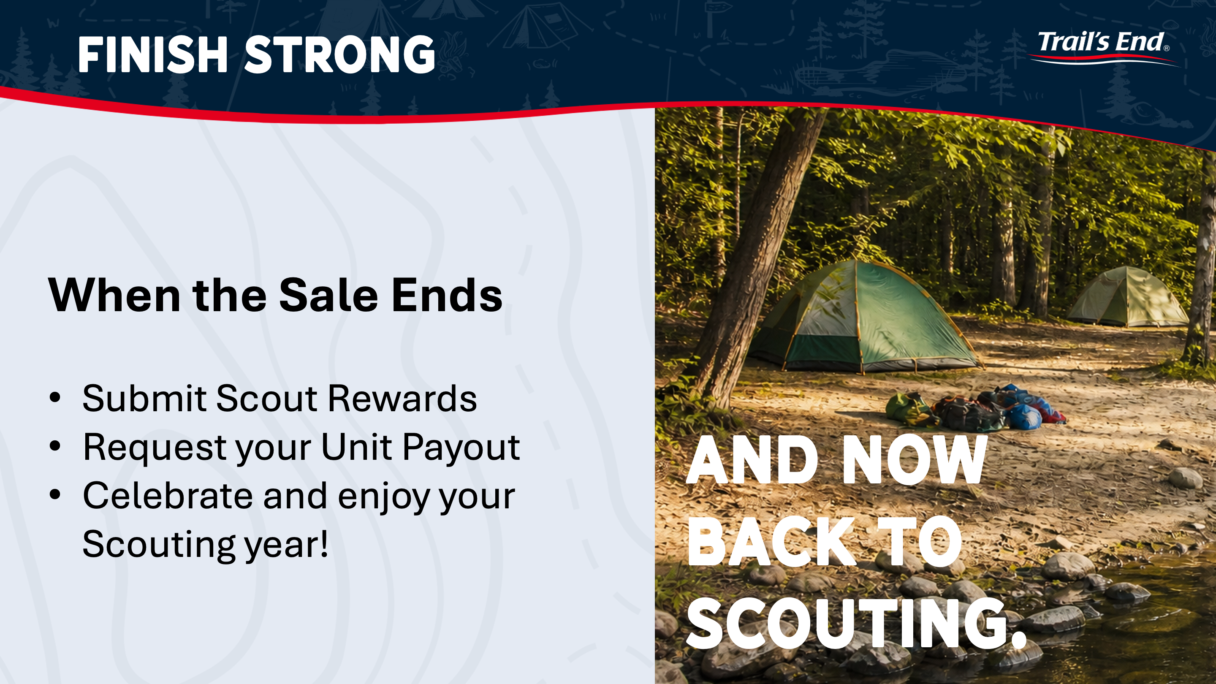

Slide 12
Council Details
Dates
Aug 16th - Initial Order Due
Aug 29th - Bonus Commission Submission Due
Week of Aug 31st - Initial Order Pick-up
Sept 13th - Second Order Due
Sept 25th - Second Order Pick-up
Sept 27th - Third Order Due
Oct 9th - Third Order Pick-up
Oct 31st – Returns*, Final Order, and Payment Due
Nov 14th - Final Order Pick-up
Re-Orders
2 additional “Formal” re-order placed through TE 9/13 and 9/27
You will be able to re-order full cases weekly from a limited Council Inventory
Commission
33% - Base (Storefront & Wagon)
+2% - Kick Off Presentation Bonus
35% - Online
Returns*
A Unit may return up to 20% of their Initial Order
Returns must be in FULL and UNOPENED cases
Returns are due to the Council Office, scheduled with Reed on Oct 31st

Slide 13
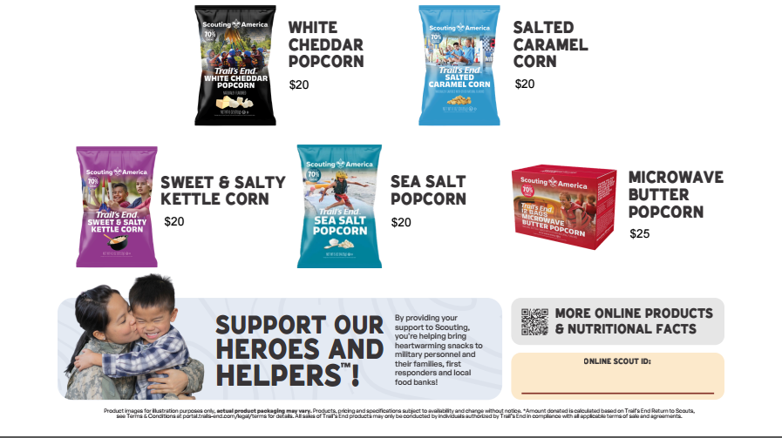
2026 Product Line Up

Slide 14


2026 NEW UNIT Promo
100% commission on a case of White Cheddar and Sea for Units that did not sell in 2025 ($480 retail)
  TE will issue the credit
Requirements: (1) Minimum two 2-hour storefront shifts (4 hours total), (2) two cases must be sold by 10/31, and (3) record all sales in the Trail's End in App®
For more info, call or email Reed Wiesneski
  Phone: (503) 225-5708
  Email: reed.wiesneski@scouting.org
Notes:
TK – help with national data
Big Numbers with bullet points
Need to highlight – millions of Rewards ($3.3M), $ to Councils ($18.9M) and units ($11.1M)
Chance to set the direction (strategically)
Per Scout Avg.
sales per Scout hr
# of Scouts per Shift
Add payout dates for Councils and units
Unit AR as of Dec 1 or 15
Heroes & Helpers up 15% auto order
Unit ordered retail $70,611,526 + online retail $9,218,398
Product cost from Sage - $25,817,692

Slide 15

Unit Growth Incentives!
ANY UNIT THAT PARTICIPATED IN THE 2025 POPCORN
SALE ARE ELIGABLE TO RECIEVE THE INCENTIVES BELOW
Increase by $2,500 over 2025 Sale - $200 CPC Scout Shop Credit
Increase by $5,000 over 2025 Sales - $400 CPC Scout Shop Credit
Increase by $7,500 over 2025 Sales - $600 CPC Scout Shop Credit

Slide 16

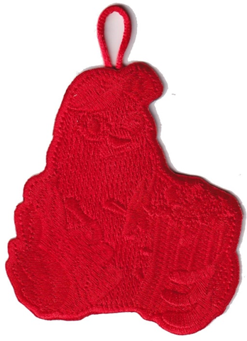


CPC Scout Prizes!
Top 50 Club
The top 50 Scouts who sell $2,500 or more will receive an invitation for themselves and one (1) parent or guardian to an exclusive Top Sellers Party
Adventure Club
All Scouts who sell $1,500 or more will receive a CPC First aid Kit and 2025 Popcorn Yeti Water Bottle!
Grit Club
All Scouts who sell $750 or more will receive a limited-edition Snack Attack patch!
$1 Club
Sell 1 item and get a Snack Attack Patch!
Examples*

Slide 17

Heros and Helps CSP!
SCOUTS
Any Scout that sells at least $250 in
Heroes & Helpers Donations will
receive an exclusive Council Shoulder Patch
LEADERS
For every 5 Scouts who collect a
minimum of $250 in Heroes & Helpers
Donations, a leader will also earn 1
exclusive Council Shoulder Patch
*Example

Slide 18
Next Steps
Place First Order 8/16
Hold Unit Kick Off
  Get Scouts excited, informed and PREPARED!
Submit Bonus Commission Form
First Order Pick up Week of 8/31

Slide 19

Council Support
Reed Wiesneski
reed.wiesneski@scouting.org
(971) 337-5923

