Slide 1
2025 Spring Snack Attack Unit Training
Wednesday January 8th 2025 7 p.m.

Slide 2
Why?
Fund Scouting Adventures
Summer Camp
Weekend Activities
Meeting Supplies
Equipment
Advancement
MORE!
Scouts Learn Vital Skill
Goal Setting
Money Management
Salesmanship
Public Speaking

Slide 3
Sale Timeline
Commission
Jan 8th - Unit Training
Jan 31st - First Order Due
Feb 17th-21st - First Order Pick-up
Re-Orders Sunday Starting 3/2
March 31st - Returns Due
April 11th - Payments Due
30% on all Products

Slide 4
Sale Tactics
Sell at:
Local Businesses
Parents’ Workplace
Church/Community groups
Encourage friendly competition
Unit Level recognitions/incentives
Storefront Update
Select Safeway/Albertsons Locations
March 17th - April 6th

Slide 5
Products
Tillamook Country Smoker Meat Sticks
$36/Bag, $1.50/Stick
24 Per Bag
12 Bags Per Case
Cases are not mixed
Full bags are returnable*
$1 Chocolate Bars
60 Bars per case
12 Crisp Bars
12 Caramel Bars
12 Almond Bars
12 Wafer Bars
6 Milk Chocolate
6 Dark Chocolate
Full, Unmarked Cases Returnable*
$3 Chocolate
3 Different types of cases
Caramel Swirls
Mint Melts
Chocolate Almonds
20 Items per case
Only available on 1st order
Not Returnable
*2025 return policy is updated, see next slide

Slide 6
2025 Return Policy
A unit may return full and unmarked $1 Candy Boxes and full bags of Meat Sticks up to 15% of their total orders.
After 15% there will be a restocking fee of 10%
$3 Boxes are not returnable

Slide 7
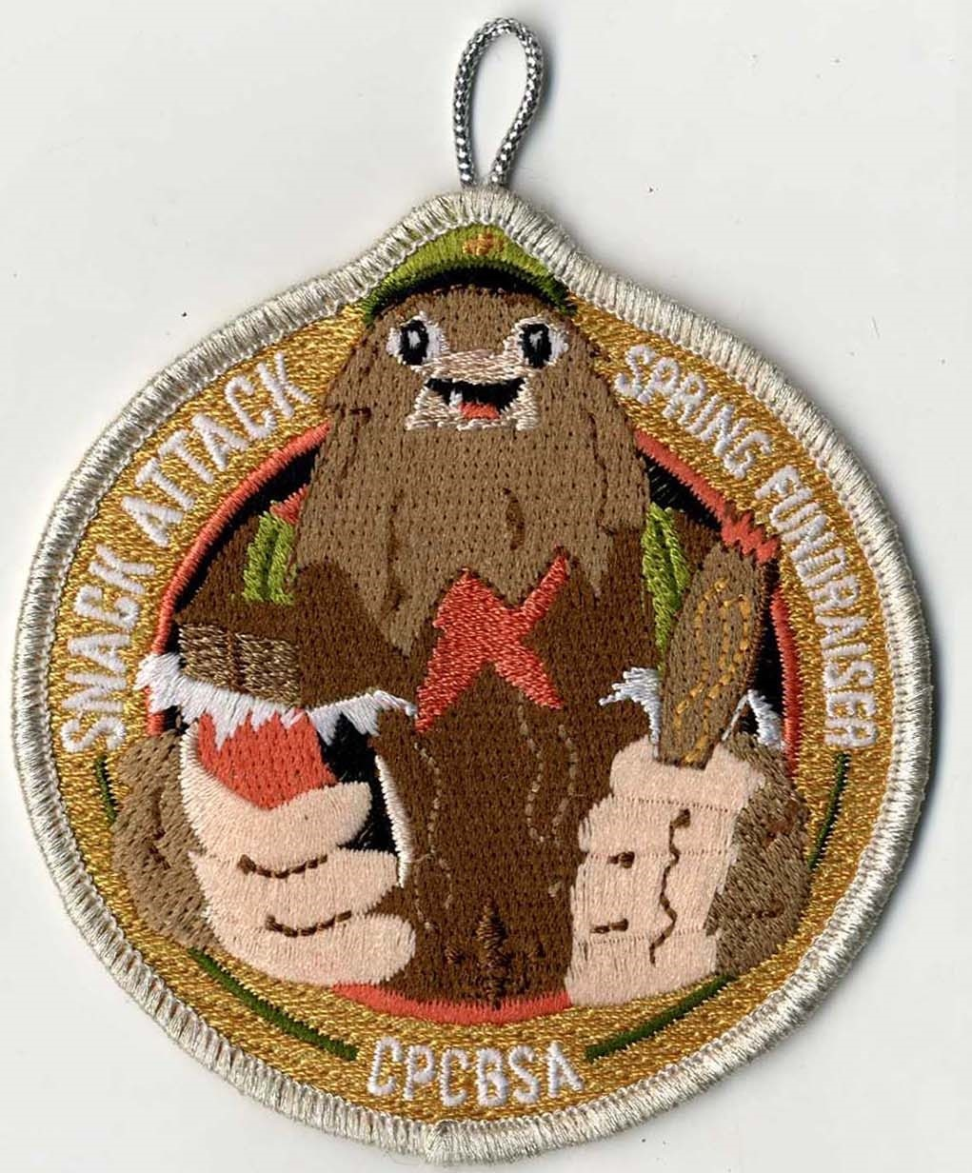
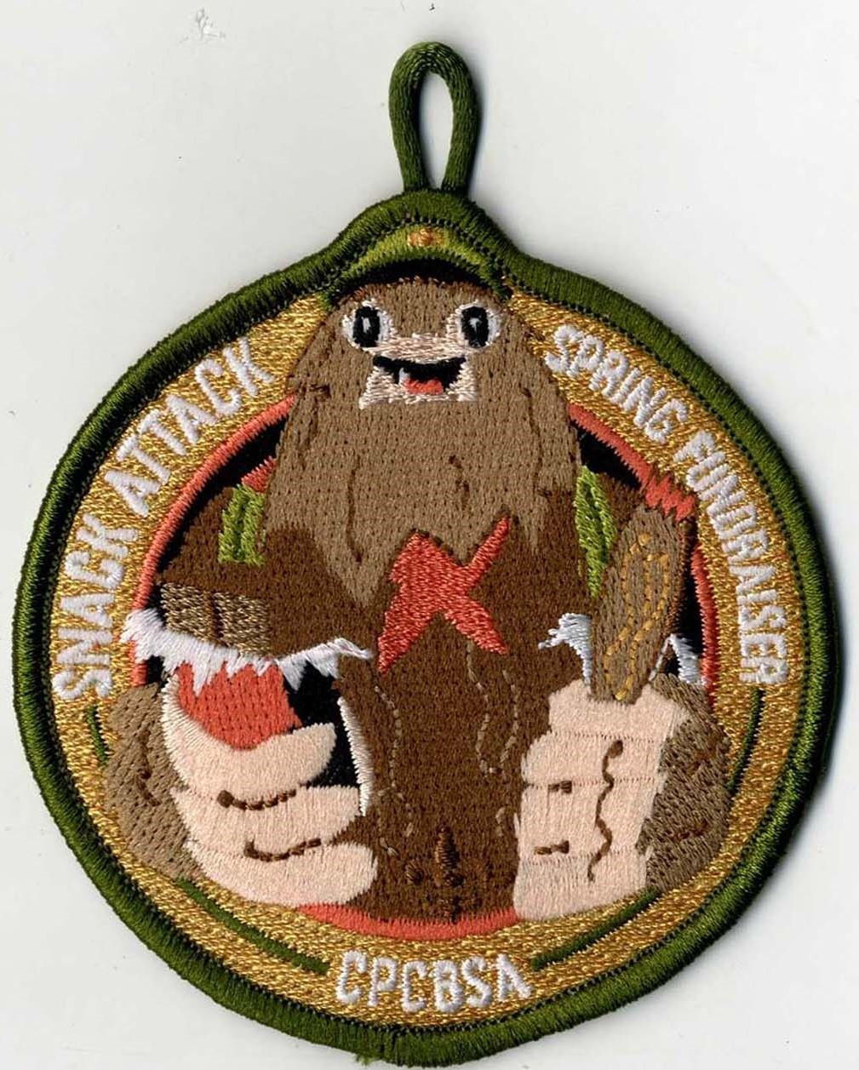
CPC Offered Incentives
Weekly Drawings
Scouts can be entered into weekly drawings for $25 CPC Shop Credit
Scout must sell $96 or more in the week(s) they are entered
Patches
Participation Patch
Unit Top Selling Scout Patch
Examples*

Slide 8
CPC Offered Incentives (NEW!)
New Selling Unit Bonus
Did not sell candy in 2024
Sell at least $1500 by 3/31
Will receive $200 credit to invoice
Unit Sale Increase Reward
Increase from 2024 candy sale by 3/31
$1000 = $100 CPC Shop Credit
$3000 = $300 CPC Shop Credit
$5000 = $500 CPC Shop Credit

Slide 9
Sale Contacts
CPC Sale Staff Advisor
Reed Wiesneski
reed.wiesneski@scouting.org
(971) 337-5923
District Contacts
Cascadia: Joe McCleary
joseph.mccleary@scouting.org
(971) 337-5919
Timberline/Mid-Columbia: Brain Morrissey
brian.morrissey2@scouting.org
(971) 337-5921
River’s Edge: Fernanda Torres
fernanda.torres@scouting.org
(503) 225 5540
Santiam River: Michael Vander
michael.vander@scouting.org
(503) 225-5731
Spirit Lake: Reed Wiesneski
reed.wiesneski@scouting.org
(971) 337-5923
Pacific Trail: Virginia Molina
virginia.molina@scouting.org
(971) 337-5915
Pacific Shores: Wendy Keller
wendy.keller@scouting.org
(503) 779-2617

