Slide 1

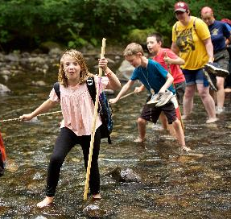
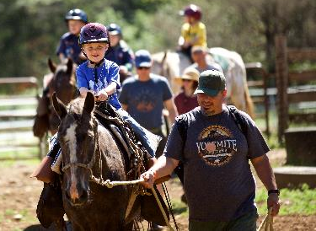
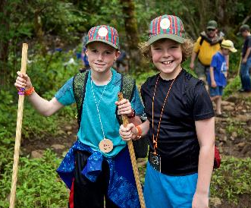
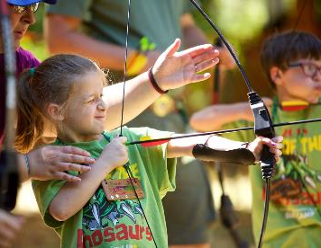
Why Cub Scouts?
Because Adventure, Grit & Growth Starts Here!

Slide 2
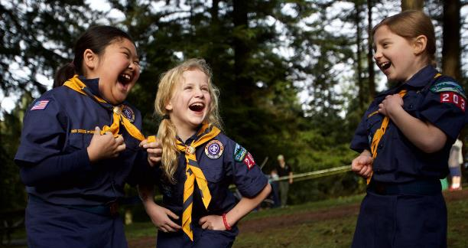
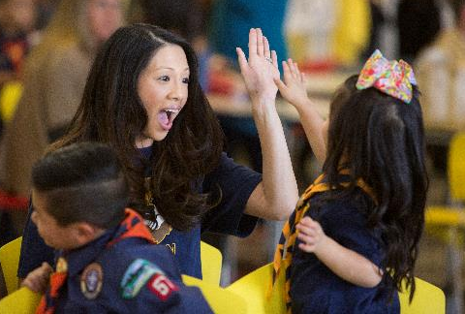
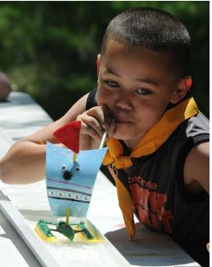
Who is Cub Scouts for?
Boys and girls (yes, girls too!) Kindergarten – 5th grade!
Parents who want a safe place for their kids learn and grow!
Families who want to have fun together!

Slide 3

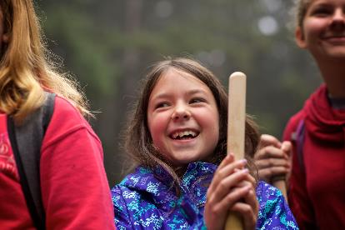
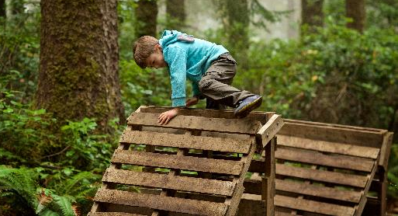
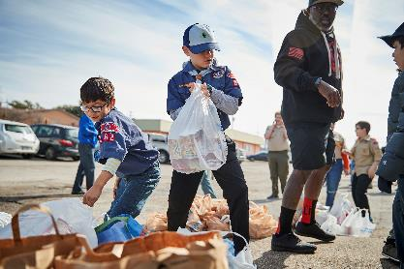
What do we do?
Get kids unplugged and outdoors!
Help kids grow in character and confidence!
Serve local communities!
Prepare youth for career and life!

Slide 4
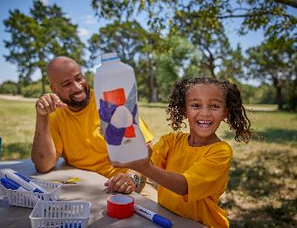
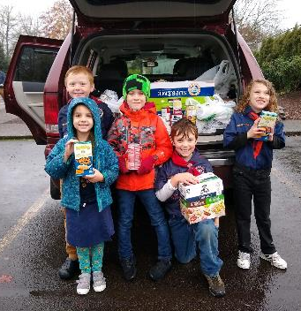

We Create a Safe Place to Grow
We have an unparalleled youth protection & safety program where:
A minimum of two adults are always with kids. No child is left alone with an adult. Ever.
We have a 2:1 ratio of youth to adults in the local program
Adult and volunteers have top-tier training for activities and outdoor safety
Strict safety protocols at summer camp keep kids safe during aquatics, climbing, shooting, horseback riding and more.
LEARN MORE @ CPCBSA.ORG/SAFETY

Slide 5
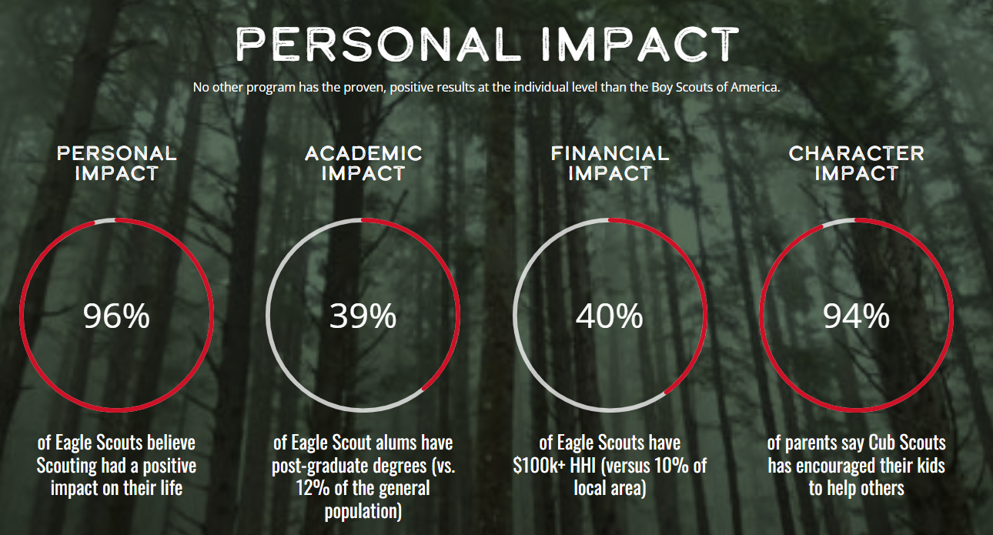
Some
Fun
Facts!

Slide 6
More Fun Facts!
In 2022, our local council and it Scouts:
Got outdoors
More than 7,000 youth and leaders attended summer camp!
More than 40,000 nights were spent outdoors by Scouts, volunteers and family members!
Served Local Communities:
More than 40,000 hours of community service was conducted
Tens of thousands of pounds of food collected for local food banks
Experienced Unparalleled Personal Growth
84% of our Cub Scouts advanced in the program in 2022!

Slide 7
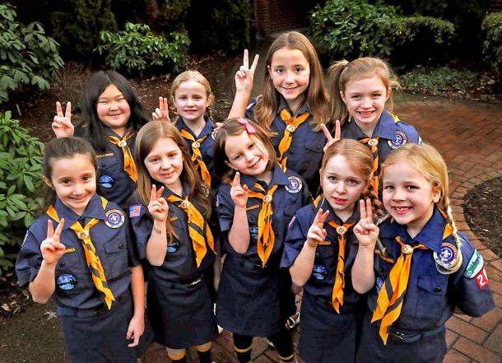
What do parents say about Scouting?
According to the BSA’s 2022 “Voice of the Scout” survey, these are the top reasons parents recommend Scouting to other families:
“Scouting is really fun for our kids.”
“Scouting is a great value for the money.”
“Scouting is our partner in providing positive youth
programs to meet our family’s goals.”
“Being in Scouting makes our family feel like we are
part of something bigger than ourselves.”
“Scout meetings are a good use of our family’s time.”
“Scouting is constantly reinforcing worthwhile values.”
“Our family feels like we belong in our Scout unit.”

Slide 8

SUPPORT SCOUTING TODAY BECAUSE
LEARN MORE @ CPCBSA.ORG

